Slide 1
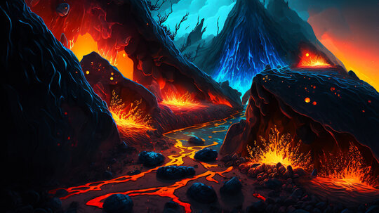
Volcanic Eruption Simulation
Presented By :-
Gugulothu linganna

Slide 2

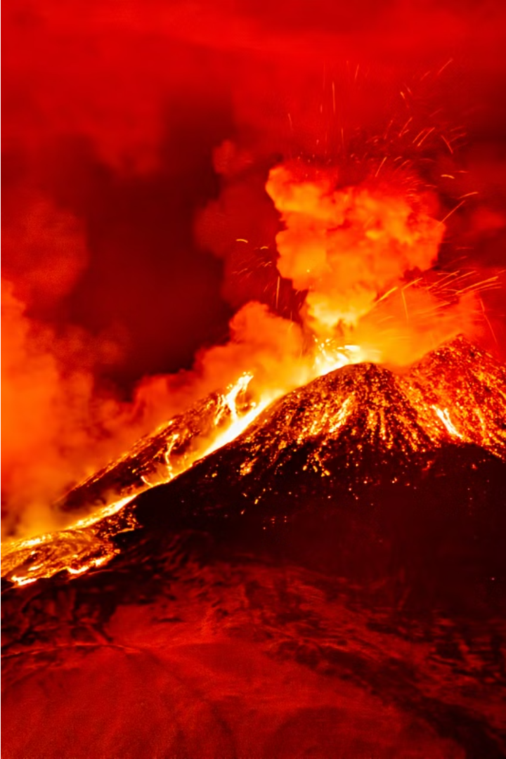
Volcanic Eruption Simulation Using C Graphics
This project aims to create a captivating visual simulation of a volcanic eruption using the powerful graphical capabilities of the C programming language. The simulation will bring to life the dynamic and awe-inspiring forces of nature, allowing users to experience the raw power of a volcanic event.
BT

Slide 3
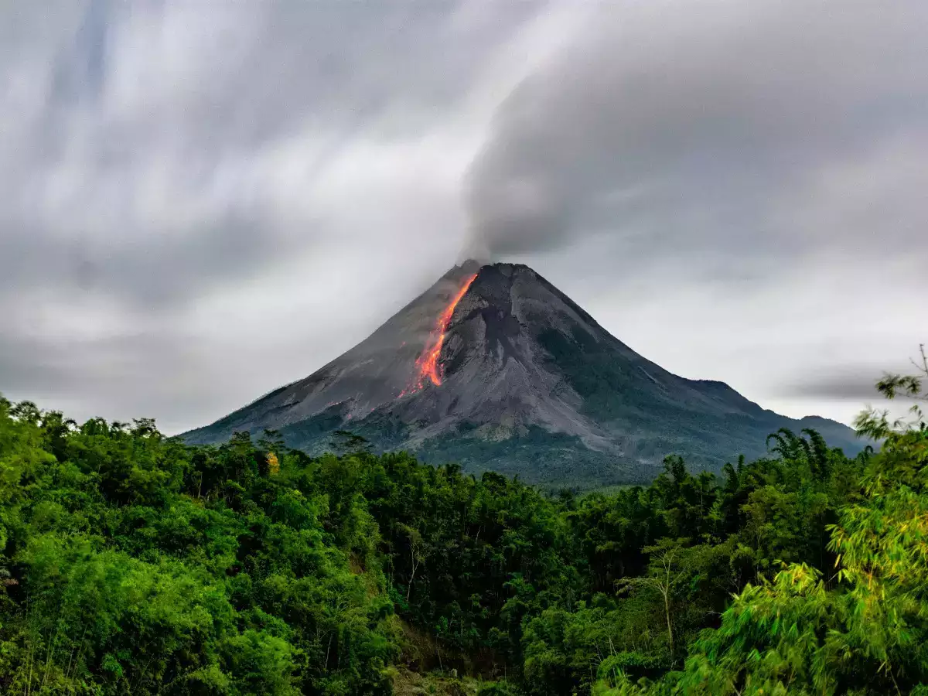
Objectives and Scope
1
Realistic Lava Flow
2
Ash Cloud Dispersion
3
Interactive Visualization
Accurately model and animate the behavior of molten lava as it flows down the mountainside.
Simulate the complex patterns of ash and smoke dispersing through the air during the eruption.
Provide users with an engaging and interactive experience to explore the volcanic eruption.

Slide 4
Graphical Capabilities in C
Drawing Primitives
Color Manipulation
Animation Techniques
Leverage C's built-in functions for drawing lines, circles, rectangles, and other shapes to create the volcanic landscape.
Utilize color palettes and gradients to accurately depict the fiery reds and oranges of the lava and the billowing grays of the ash cloud.
Implement frame-by-frame animation to bring the volcanic eruption to life, with smooth transitions and dynamic movements.
Functions Used
Color Code
Setfillstyle()
Setcolor()
Floodfill()
Line()
Rectangle()
Drawpoly()
Ellipse()
Pieslice()
Outtextxy()
Delay()
Closegraph()
0.BLACK
1.BLUE
2.GREEN
3.CYAN
4.RED
5.MAGENTA
6.BROWN
7.LIGHTGRAY
8.DARKGRAY
9.LIGHTBLUE
10.LIGHTGREEN
11.LIGHTCYAN
12.LIGHTRED
13.LIGHTMAGENTA
14.YELLOW
15.WHITE

Slide 5
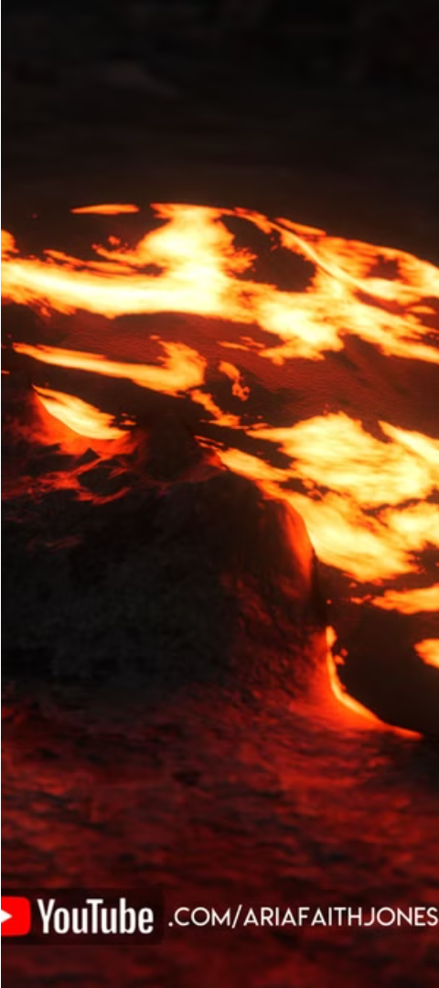
Representing Lava Flow
1
Initial Eruption
Simulate the initial burst of molten lava from the volcano's crater, with realistic patterns and textures.
2
Downslope Movement
Model the lava's descent down the mountainside, accounting for terrain features, gravity, and fluid dynamics.
3
Cooling and Solidification
Depict the gradual cooling and hardening of the lava as it travels, creating a sense of flow and texture.

Slide 6
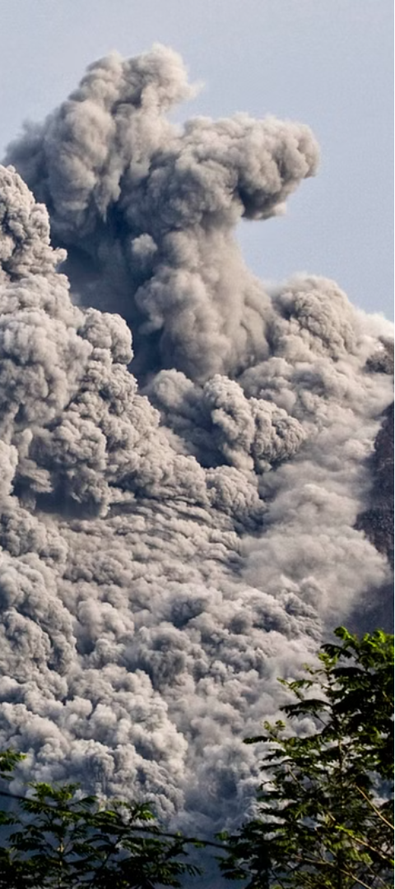



Simulating Ash Cloud Dispersion
Ash Ejection
Simulate the initial ejection of ash and debris from the volcano's crater, creating a towering column.
Atmospheric Dispersion
Model the complex patterns of ash and smoke dispersing through the air, influenced by wind and weather conditions.
Ground Deposition
Visualize the gradual settling of ash and debris on the surrounding landscape, creating a layer of volcanic ash.

Slide 7
Techniques and Algorithms
Fluid Dynamics
Particle Systems
Apply computational fluid dynamics algorithms to realistically simulate the flow and behavior of the molten lava.
Utilize particle systems to model the complex patterns and movements of the ash cloud and debris.
Terrain Mapping
Real-time Rendering
Incorporate detailed terrain data to accurately depict the landscape and its impact on the lava and ash flow.
Optimize the simulation for real-time rendering, ensuring a smooth and responsive user experience.

Slide 8
CODE :-
#include<graphics.h>
#include<conio.h>
#include<conio.h>
#include<math.h>
#include<stdlib.h>
int main()
{
int gd=DETECT,gm;
float i=0,j=0;
int k=0,l=0;
int trpz[]={349,380,325,150,324,150,300,380};
int trpzl[]={140,380,300,380,323,160,300,204,260,248,210,292,160,340,150,360,140,380};
int trpzr[]={349,380,560,380,510,340,460,290,410,240,350,190,326,160,349,380};
initgraph(&gd,&gm,"C:\\Turboc3\\bgi");
setcolor(13);
outtextxy(50,150," VOLCANIC ERUPTION ");
setcolor(6);
rectangle(0,380,300,400);
setfillstyle(1,6);
floodfill(1,381,6);

Slide 9
rectangle(349,380,620,400);
setfillstyle(1,6);
floodfill(350,381,6);
drawpoly(4,trpz);
setcolor(7);
drawpoly(9,trpzl);
setfillstyle(1,7),
floodfill(141,379,7);
drawpoly(8,trpzr);
setfillstyle(1,7);
floodfill(350,379,7);
for(k=0;k<300;k++)
{
setcolor(14);
line(0+k,420,0+k,435);
line(640-k,420,640-k,435);
delay(10);
}
delay(10);
setcolor(14);

Slide 10
ellipse(325,425,0,360,160,25);
setfillstyle(1,14);
floodfill(326,426,14);
delay(5);
for(;i<27 && j<400;)
{
if(j<80)
setcolor(14);
else if(j>=80 && j<200)
setcolor(LIGHTRED);
else if(j>255&&j<400)
{
setcolor(4);
pieslice(325,185,50,130,55);
setfillstyle(1,4);
floodfill(326,151,4);
}
else
setcolor(RED);
line(300+i,400-j,350-i,400-j);
delay(20);
i=i+0.1;
j=j+1;
}

Slide 11
delay(30);
setcolor(4);
line(325,125,325,90);
line(340,125,350,92);
line(355,130,380,108);
line(365,150,398,150);
line(360,165,389,190);
line(310,125,300,92);
line(295,130,272,111);
line(285,150,260,150);
line(293,165,273,188);
delay(50);
for(l=0;l<=5;l++)
{
setcolor(8);
ellipse(325,70-(10*l),0,360,40+(20*l),15);
setfillstyle(1,8);
floodfill(326,71-(10*l),8);
delay(40);
}

Slide 12
for(l=1;l<=5;l++)
{
setcolor(4);
pieslice(325,150,244-l,246,15*l);
pieslice(325,157,310,324-l,14*l);
setfillstyle(1,4);
floodfill(320,159,4);
delay(200);
}
getch();
closegraph();
return 0;
}

Slide 13
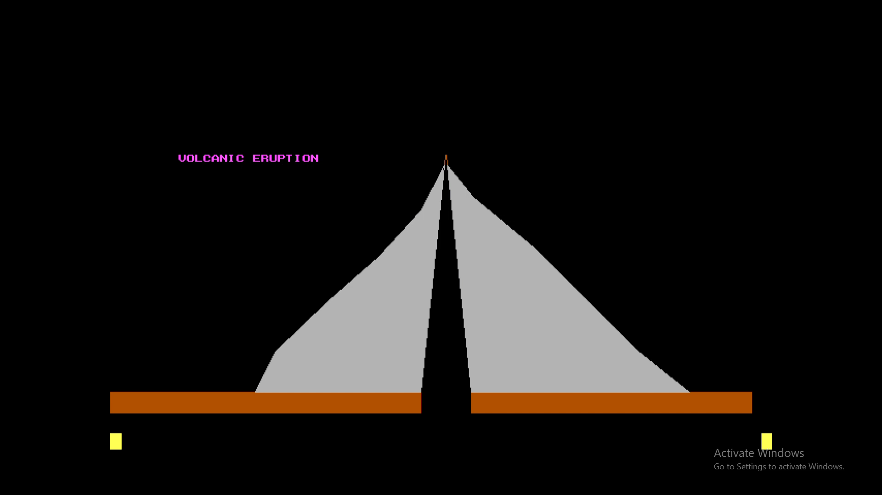
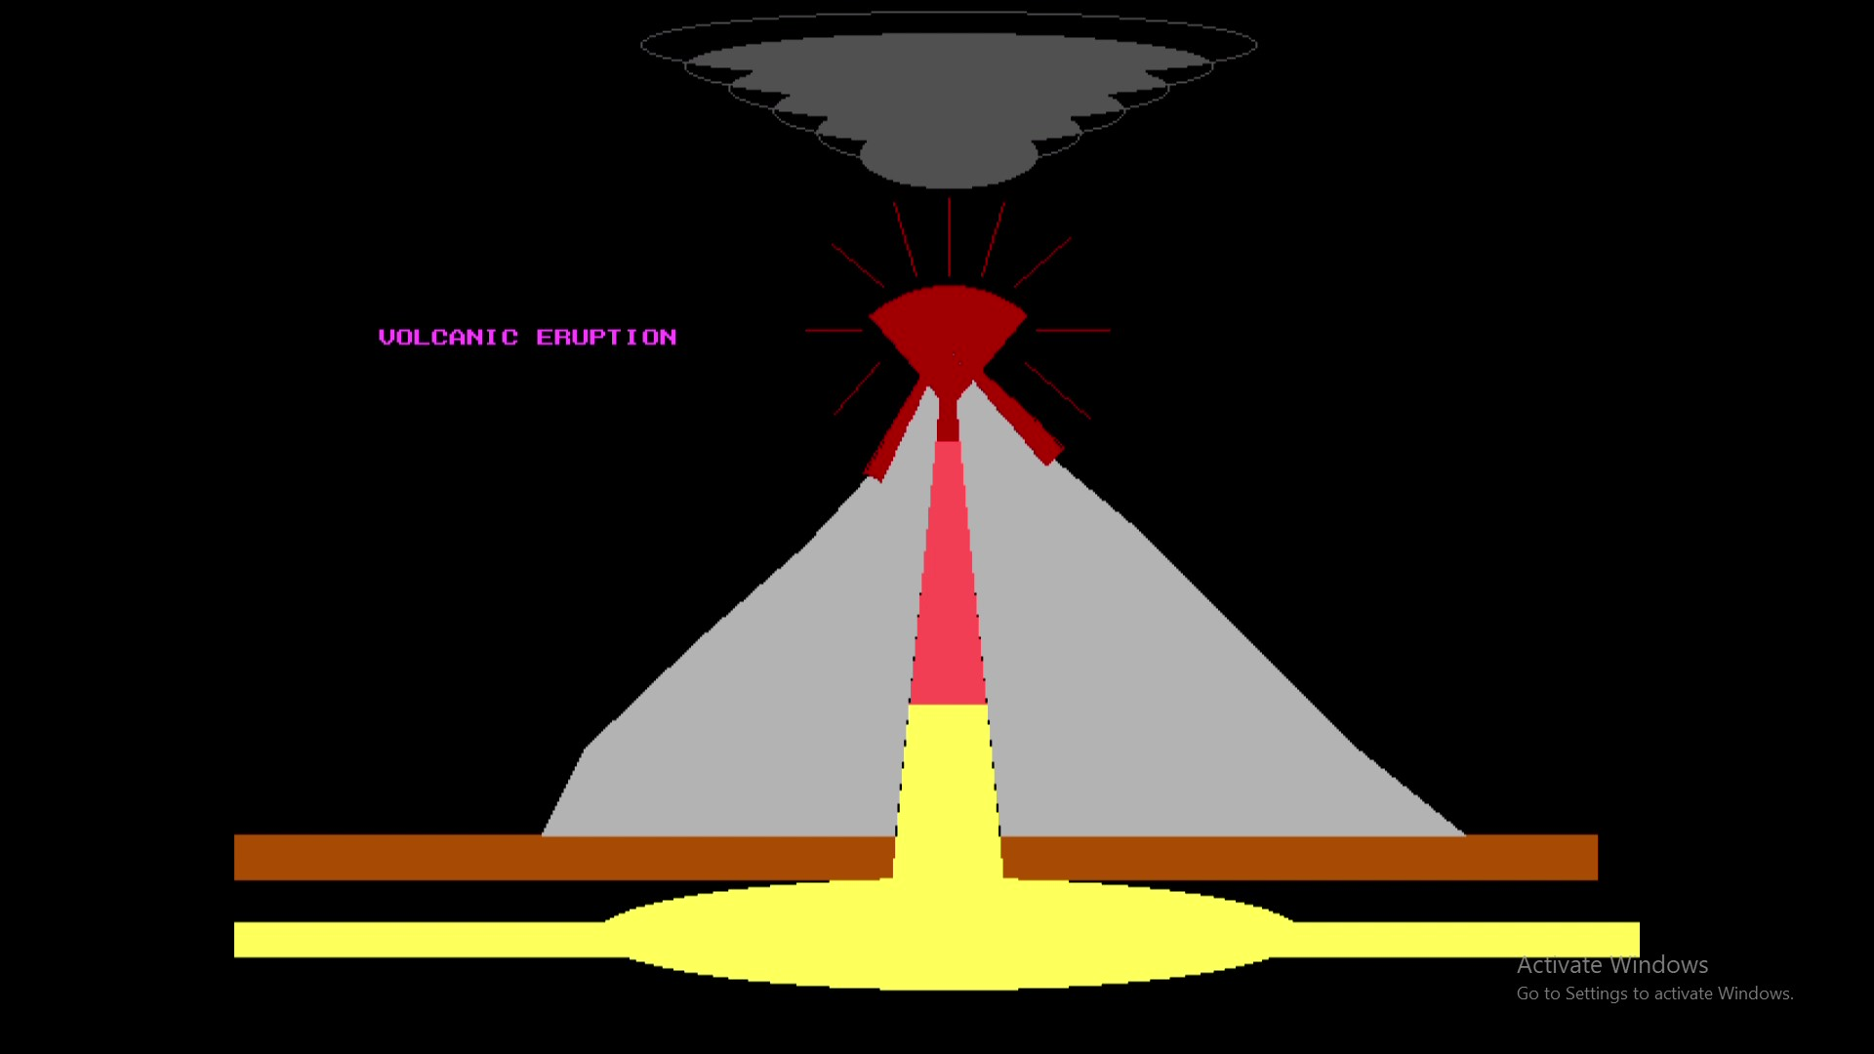
Volcanic Eruption Simulation

Slide 14




Challenges and Considerations
Performance
Realism
Interactivity
Data Sources
Ensuring the simulation runs efficiently and without lag, even on lower-powered systems.
Achieving a high degree of visual realism and accuracy in the simulation of natural phenomena.
Providing users with intuitive controls and options to explore and manipulate the simulation.
Incorporating accurate and up-to-date data on volcanic eruptions and their characteristics.

Slide 15
Conclusion and Future Enhancements
Realistic Lava Flow
Achieved through the application of fluid dynamics algorithms and detailed terrain mapping.
Ash Cloud Dispersion
Simulated using particle systems and atmospheric data to create dynamic and authentic dispersal patterns.
Interactive Visualization
Provided users with intuitive controls to explore and manipulate the volcanic eruption in real-time.
Future Enhancements
Incorporate additional volcanic phenomena, such as pyroclastic flows, earthquakes, and magma chamber dynamics, to further expand the scope and realism of the simulation.

